Slide 1
Non-Newtonian Viscosity
Group 1
Joshua Olusoji, Omar Zaruk, Sanad Abu Hweij, Qussay Suleiman
Chemical Engineering Lab I
9/16/2025

Slide 2
Introduction
The objective of the lab is to determine the non-Newtonian behavior of a 1 wt% Carbopol solution in water
A capillary tube viscometer is used to analyze flow behavior (shear-thinning vs. shear-thickening)

Slide 3
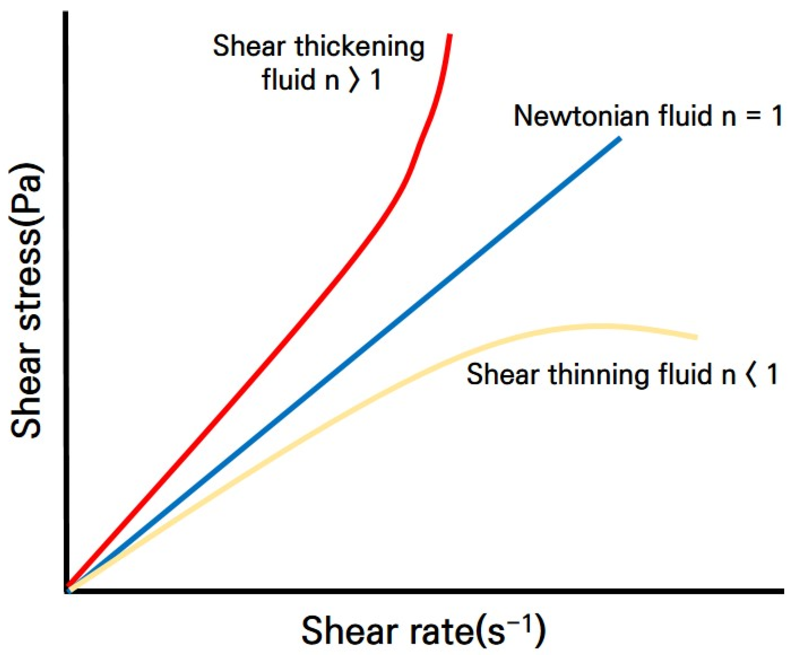
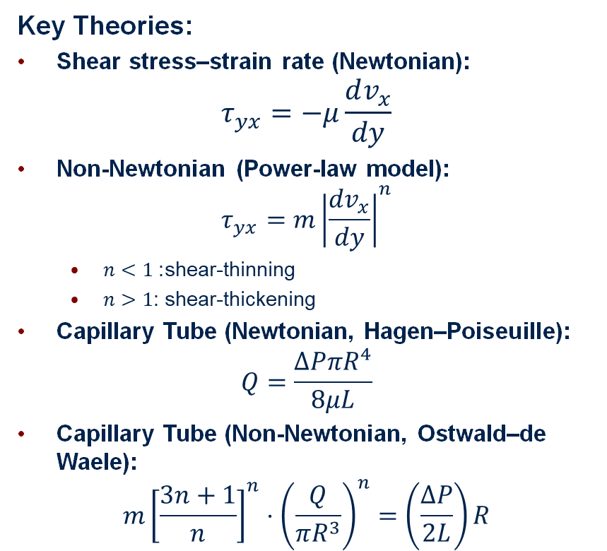
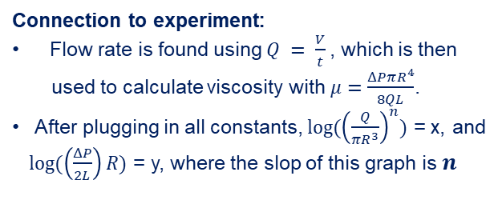
Theory
Key Theories:
Shear stress–strain rate (Newtonian): $τ_{yx}=−μ\frac{dv_{x}}{dy}$
Non-Newtonian (Power-law model): $τ_{yx}=m{∣\frac{dv_{x}}{dy}∣}^{n}$
$n<1$: shear-thinning
$n>1$: shear-thickening
Capillary Tube (Newtonian, Hagen–Poiseuille): $Q=\frac{ΔPπR^{4}}{8μL}$
Capillary Tube (Non-Newtonian, Ostwald–de Waele):
$$m{\left[\frac{3n+1}{n}\right]}^{n}⋅{\left(\frac{Q}{πR^{3}}\right)}^{n}=\left(\frac{ΔP}{2L}\right)R$$
Assumptions:
Gravity effects negligible (small elevation head).
ΔP held constant during each run (no drift/leaks).
Tubes are ideal cylinders with no wall slip
Connection to experiment:
Flow rate is found using $Q = \frac{V}{t}$, which is then
used to calculate viscosity with$μ=\frac{ΔPπR^{4}}{8QL}$.
After plugging in all constants, ${log⁡(\left(\frac{Q}{πR^{3}}\right)}^{n})$ = x, and
$log(\left(\frac{ΔP}{2L}\right)R)$ = y, where the slop of this graph is $n$

Slide 4
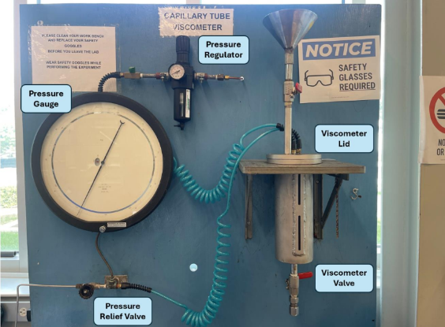
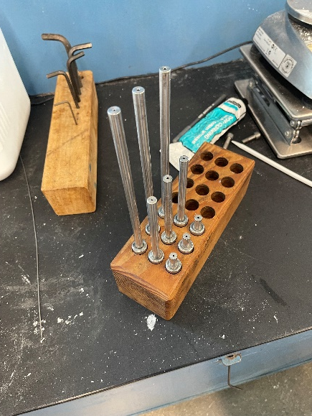
Apparatus
Capillary Tubes

Slide 5
Material & Supplies
Carbopol 934
Warm tap water
1 N NaOH solution
Beakers (1-4 L capacity)
Stirring rods
Disposable gloves
Mixer
Lab jacks
Balance
Timer device

Slide 6
Procedure
Prepare 1 wt% Carbopol in warm water; mix fully, then add NaOH untill pH 5–7.
Load solution into the pressurized vessel; seal/grease joints and mount the lid.
Connect regulator/gauge; choose a capillary and note length and diameter.
Set a ΔP setpoint, wait for steady flow, collect a set effluent volume, and record collection time and mass.
Repeat for two more ΔP setpoints, repeat the same 3 ΔP setpoints to the 5 remaining capillaries, varying in length and diameter

Slide 7
Experimental Challenges
Add Carbopol directly to the mixing bucket—adding to a water beaker wastes powder that sticks to the walls.
At startup, cover the bucket to prevent Carbopol powder from escaping during mixing.
Volume is difficult to read accurately, so record flow time and post-trial mass instead.
Low ΔP won’t sustain steady flow through longer capillaries; begin at higher pressures (≥50 psig).

Slide 8
Safety
To stay safe:
Wear gloves when handling Carbopol or NaOH
Use goggles and face protection during mixing
Avoid dust formation when working with Carbopol powder
Regulate and monitor pressure when using pressurized vessels
Keep cords and equipment dry near liquids

